Slide 1
Spectrum Employee Services New UI Overview
TITLE SLIDE

Slide 2
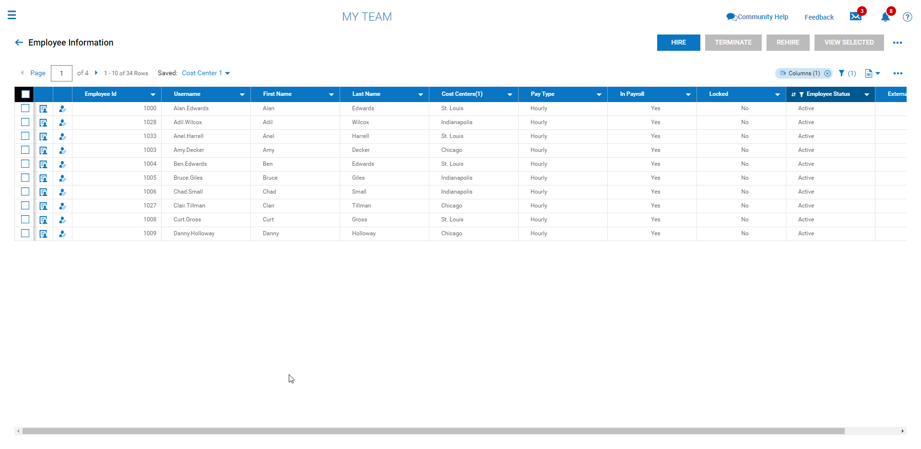
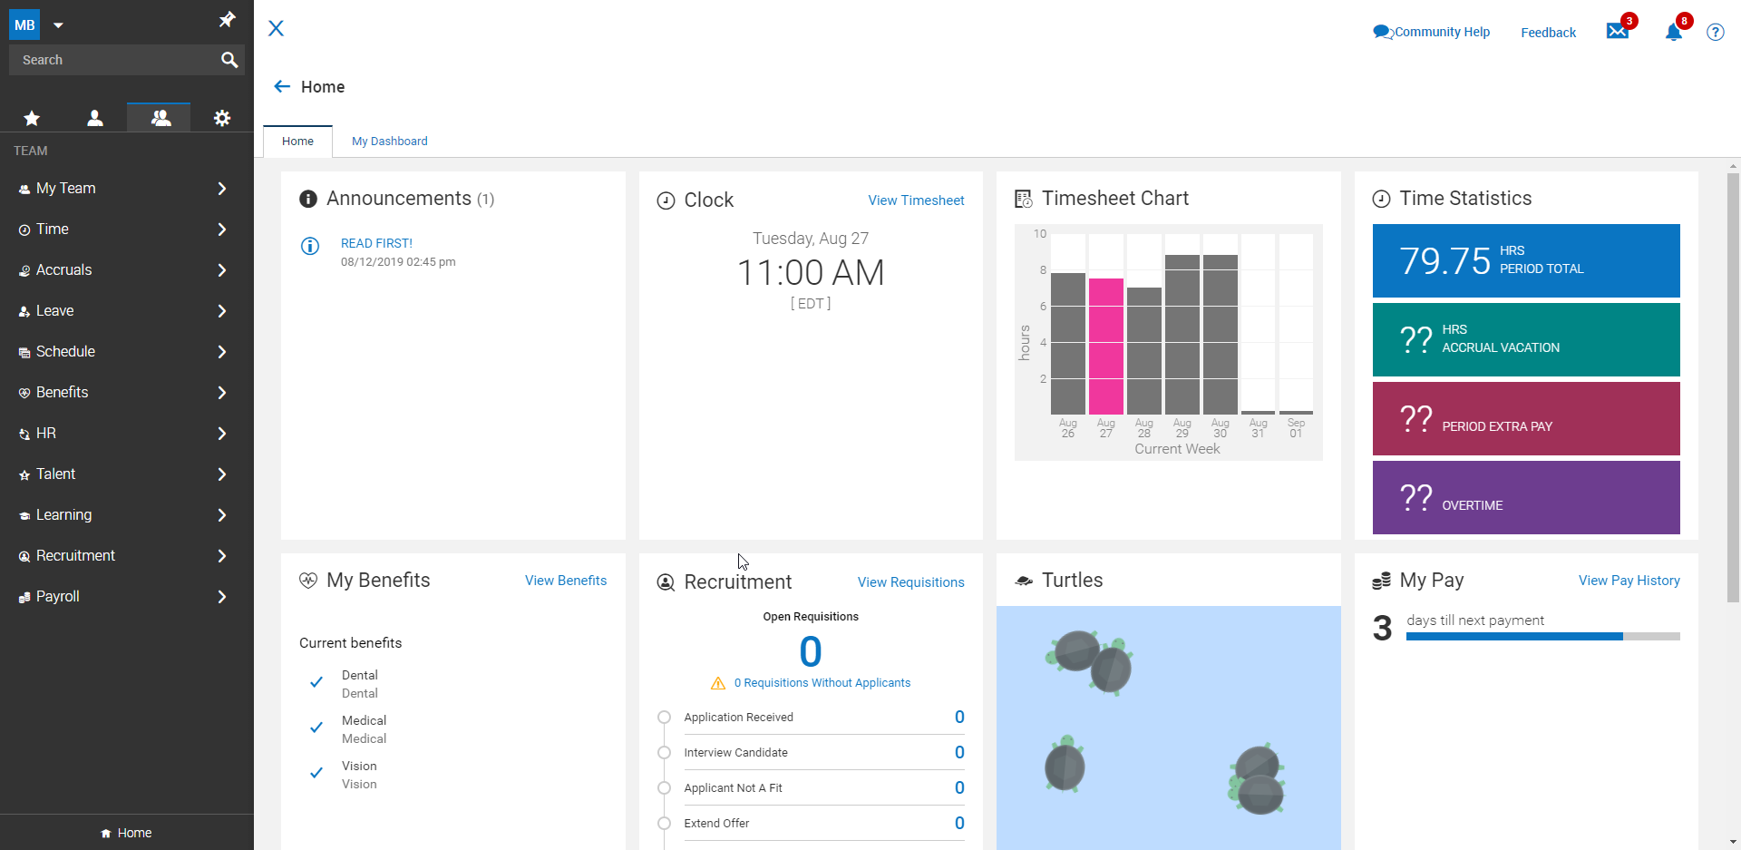
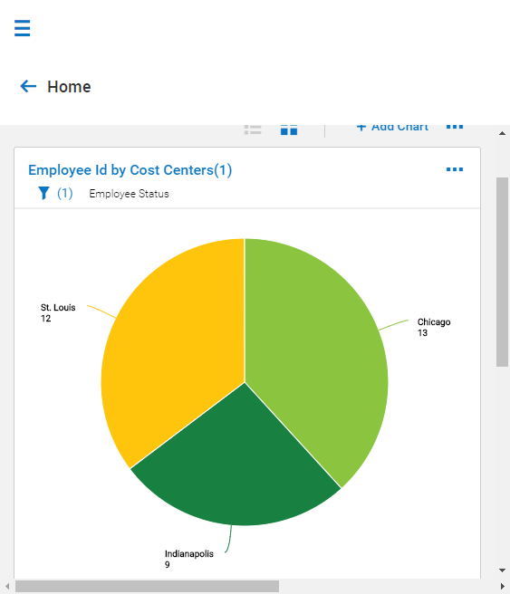
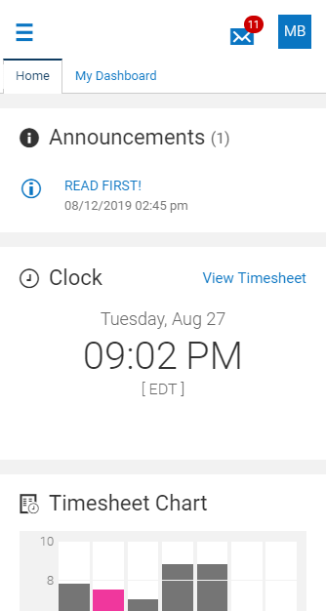
Why do we have a new UI?
User-friendly
Requires less training and explanation
Consolidated
Cleaner look with more space dedicated to needed information and less to options
Data Visualization
Charts and graphs add a visual element to your reports
Responsive
Consistent experience across all devices

Slide 3
Why do we have a new UI?
“So you can spend LESS time in the system and MORE time with your employees.”

Slide 4
New UI Navigation

Slide 5
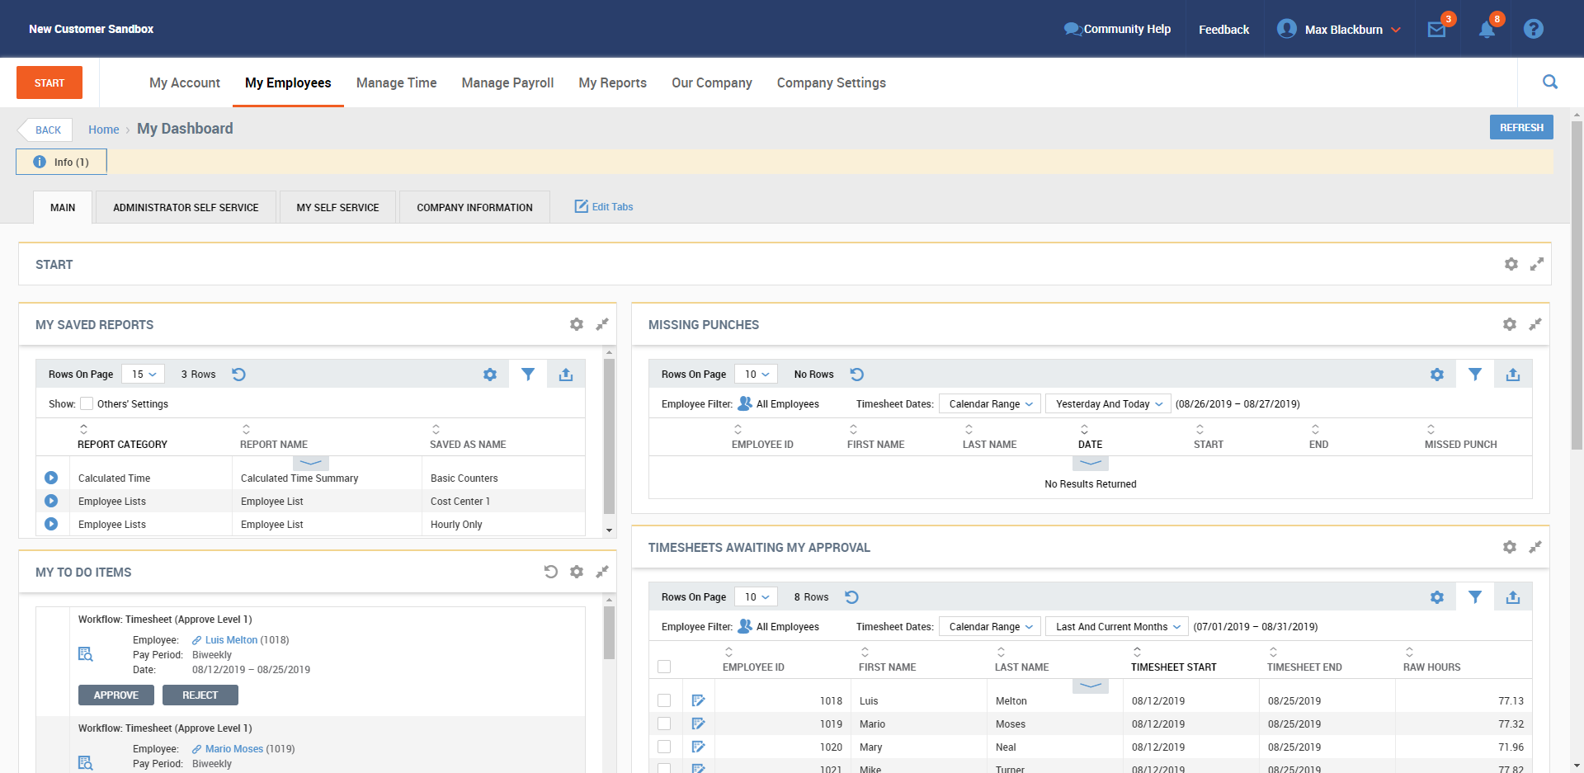
New UI Navigation
In classic UI, menu was distributed across the top.

Slide 6
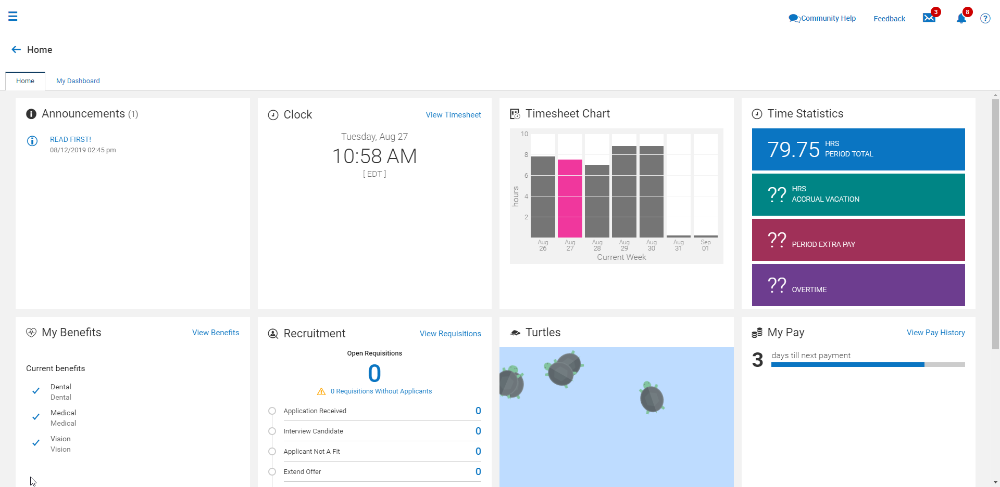
New UI Navigation
Where is the menu here?

Slide 7
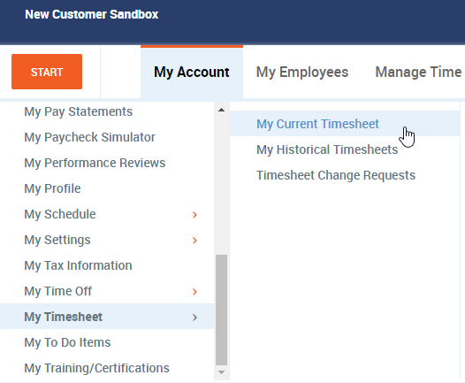
New UI Navigation
1
Classic UI had a distributed horizontal layout.
3
2

Slide 8
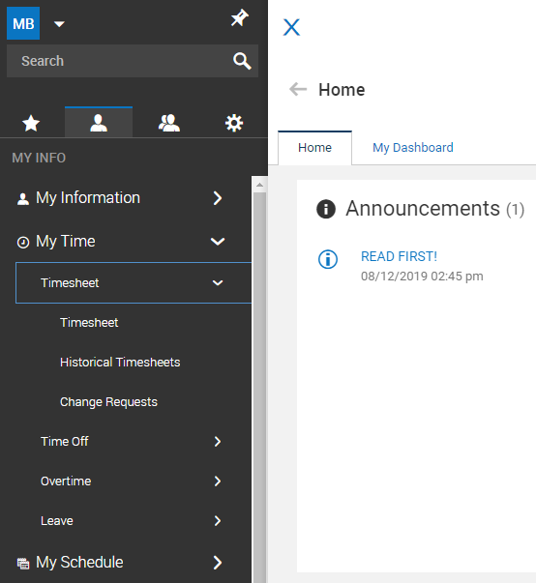
New UI Navigation
Classic UI had a distributed horizontal layout.
New UI has a consolidated vertical layout.
1
2
3

Slide 9
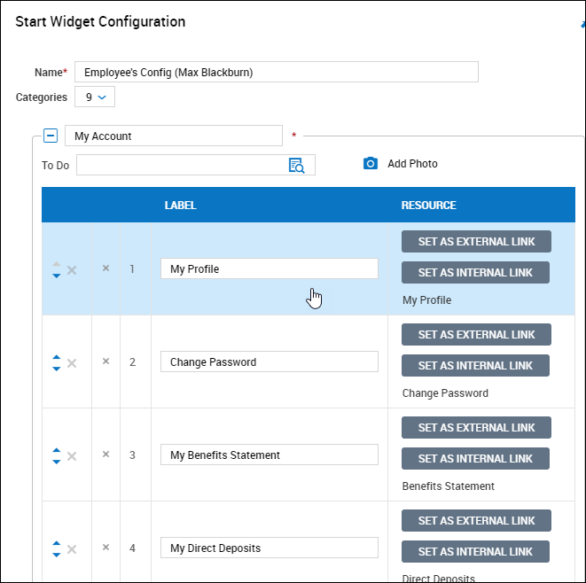
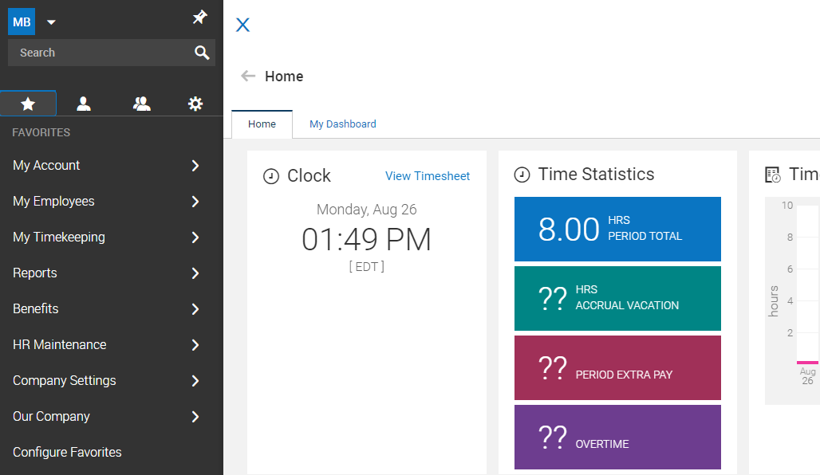
Start Menu
Start displayed configured favorites in classic UI.
Same configured favorites now found in Favorites tab.
Easily customize your favorites the same as you would in the classic experience.

Slide 10
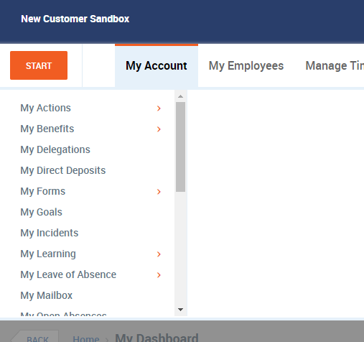
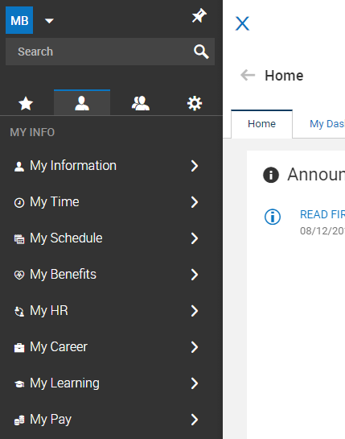
My Account
This information is now located in My Info.
My Account held information specific to the user.

Slide 11
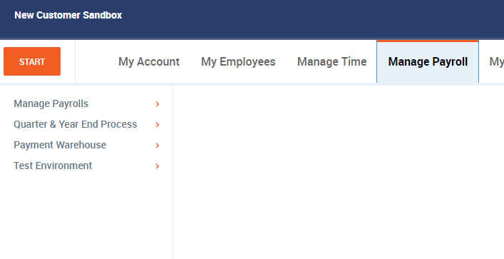
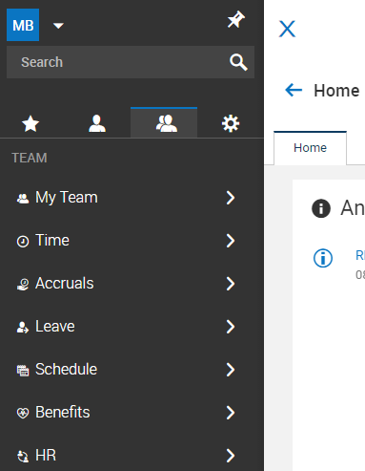
Manage Tabs
Manager-related items are now located under Team.
My Employees, Manage Time, and Manage Payroll all held manager-related items.

Slide 12
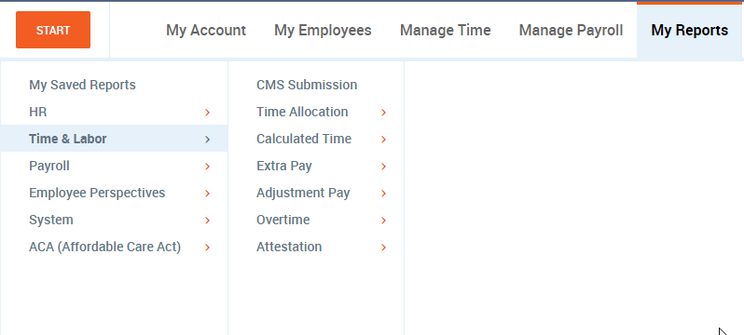
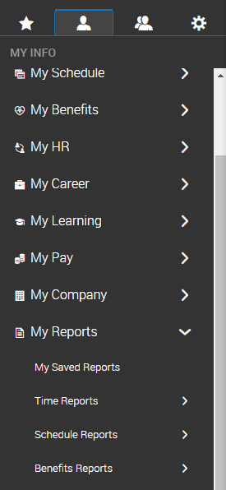
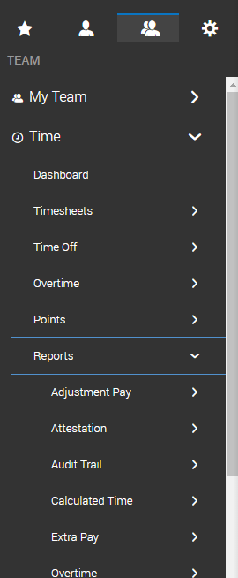
My Reports
These same reports are now found under My Info, or can be found under Team within each module category.
My Reports held a variety of reports specific to different modules.

Slide 13
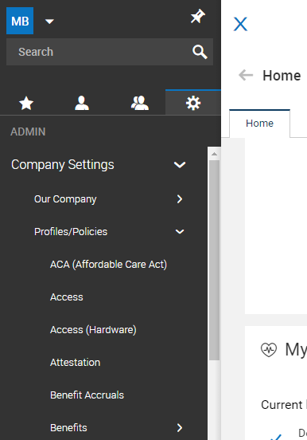
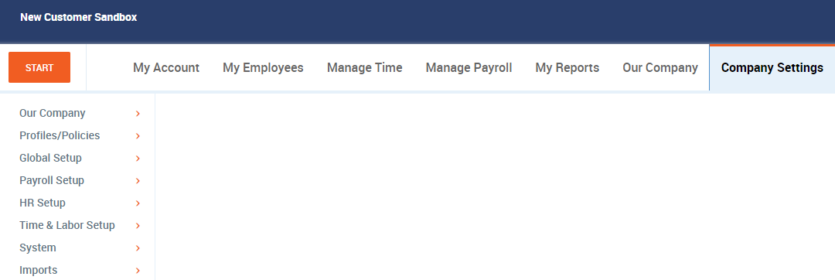
Company Settings
Company administration tasks are now located under the Admin tab.
Our Company and Company Settings is where most company configuration and administration was located.

Slide 14
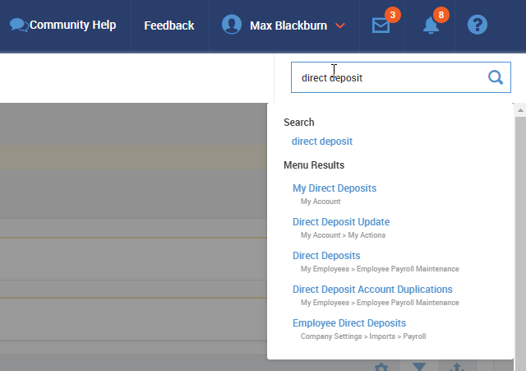
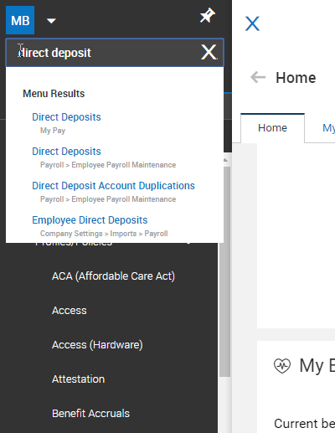
Search
Now located at the top of the system menu.
System Search was located in upper right of screen.
Notes:
Cool tip: there are several search shortcuts in the New UI. For example, we can type the pound sign in front of an employee’s name and you’ll be taken directly to that employee’s timesheet.

Slide 15
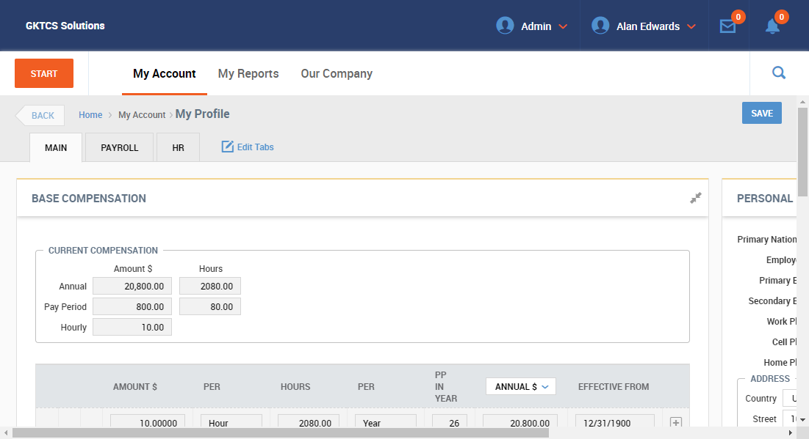
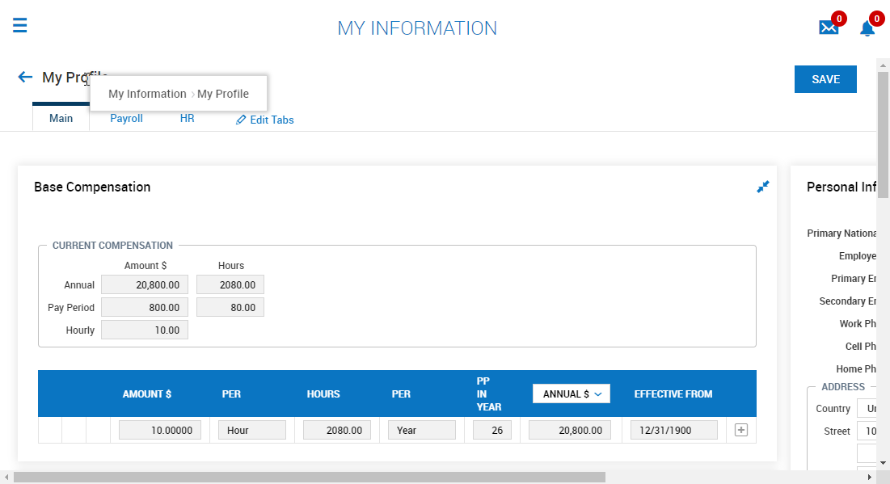
Breadcrumbs
Now displayed upon hovering over page title.
Breadcrumbs across top in classic.

Slide 16
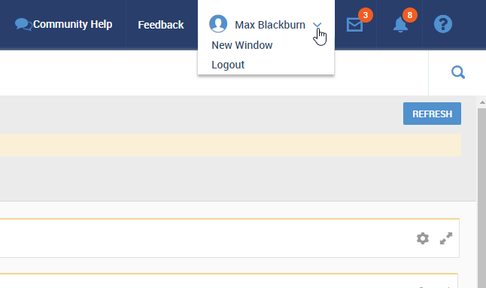
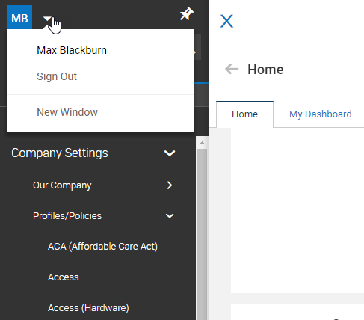
Account Options
Account options such as logging out or opening a new window were located in top right corner.
Same options now located at top of system menu.

Slide 17
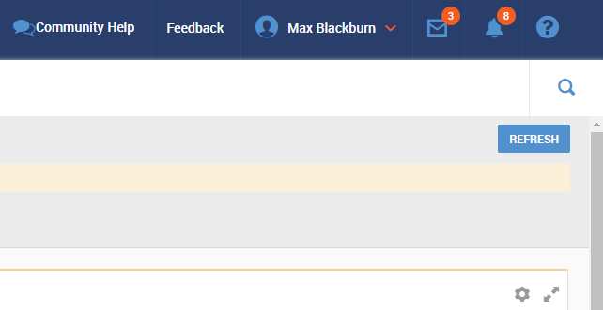
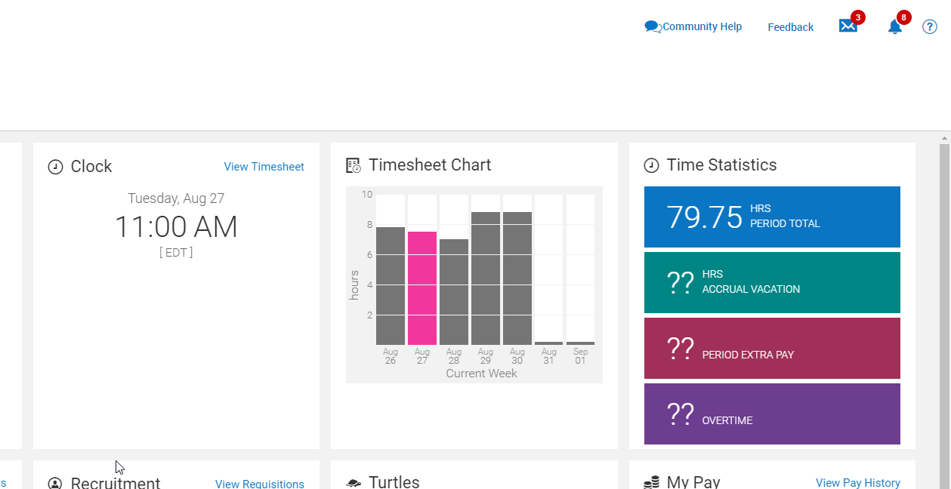
Additional Navigation
Community Help, Feedback, My Mailbox, My To Do, and Help were each located in top right corner.
Same location and function in New UI.

Slide 18
New UI Reporting

Slide 19
New UI Reporting Highlights
Same general reporting options are available.
With just a few clicks, add a visual element to your data using charts and graphs.
Notes:
-As with much of the navigation, reporting features work very similarly to how it did in the classic UI.
-A big change that we are really excited about and we know you’ll love is Charts.

Slide 20
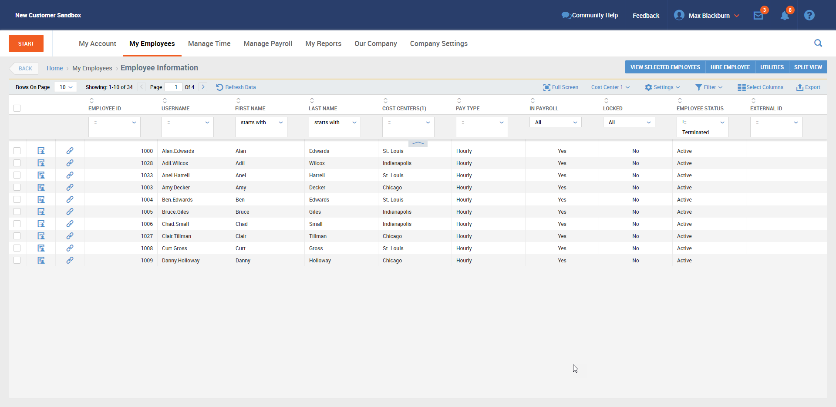
Classic vs. New UI
Notes:
-This is what the employee information report looked like in the classic UI

Slide 21
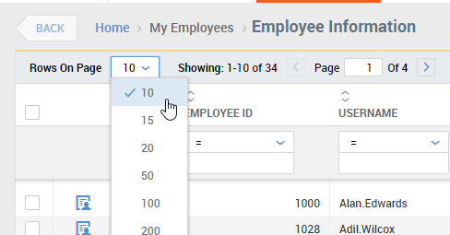
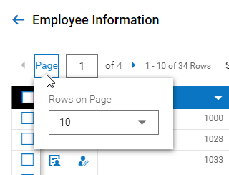
Pages and Rows
Same location, but rows per page option shown upon clicking Page.
Able to select rows per page and navigate between pages.

Slide 22
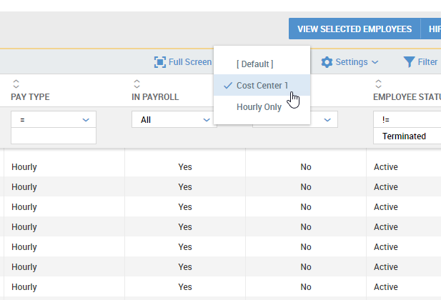
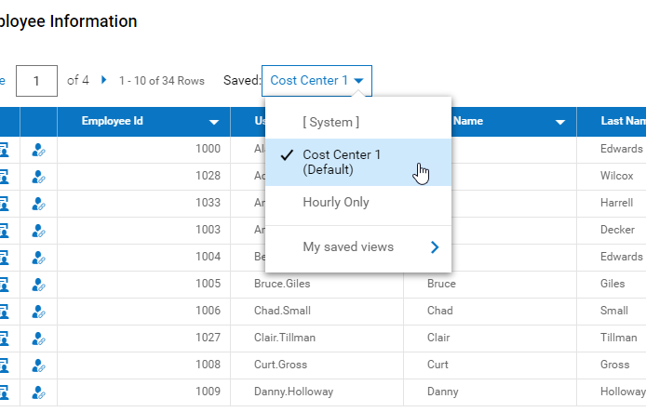
Saved Views
Was located in upper right side of screen.
Now located in upper left of screen next to pages and rows.

Slide 23
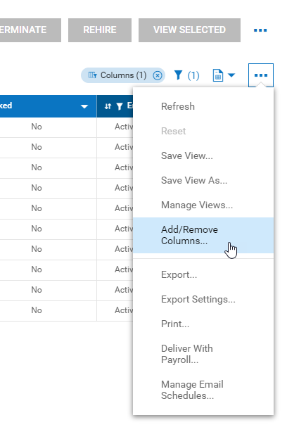
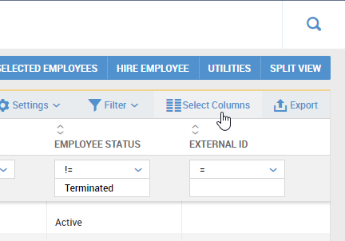
Select Columns & Ellipsis
Add/Remove columns offers same features, but is accessed via the ellipsis.
Select Columns allowed user to add or remove columns of information to the report.
View settings and Export/Print options have also been relocated to the ellipsis menu.
Notes:
Note: View settings, export, and print were all buttons or visible drop-downs in classic.

Slide 24
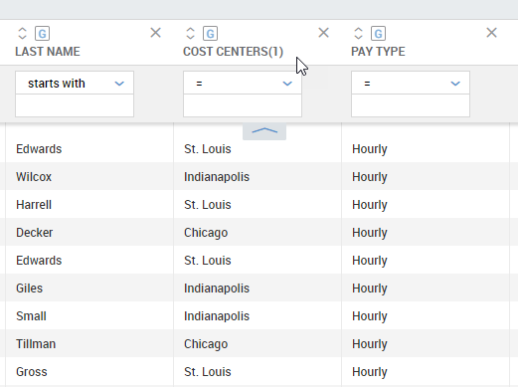
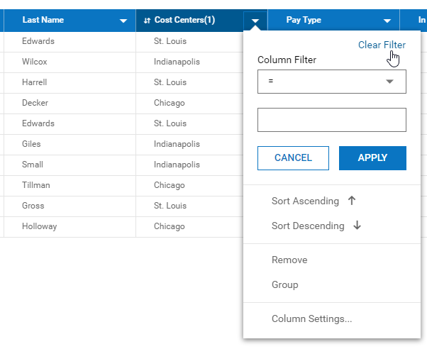
Column Filters
Column filters were all visible at the top of the column regardless of use.
Column filters now accessed via drop-down.
Notes:
Note: next slide begins a multi-slide side by side comparison of reporting features.

Slide 25
Column Filters
Sort ascending/descending
Sort ascending/descending

Slide 26
Column Filters
Group results by this column
Group results by this column

Slide 27
Column Filters
Remove column
Remove column

Slide 28
Column Filters
Filter by value
Filter by value

Slide 29
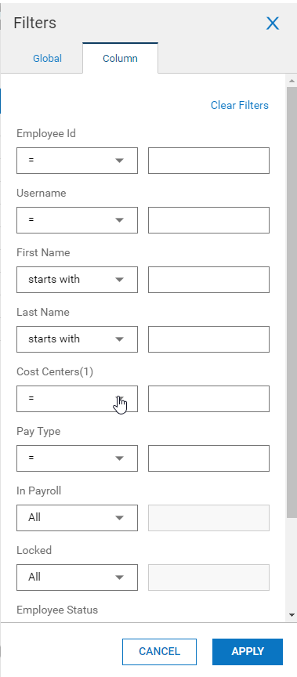
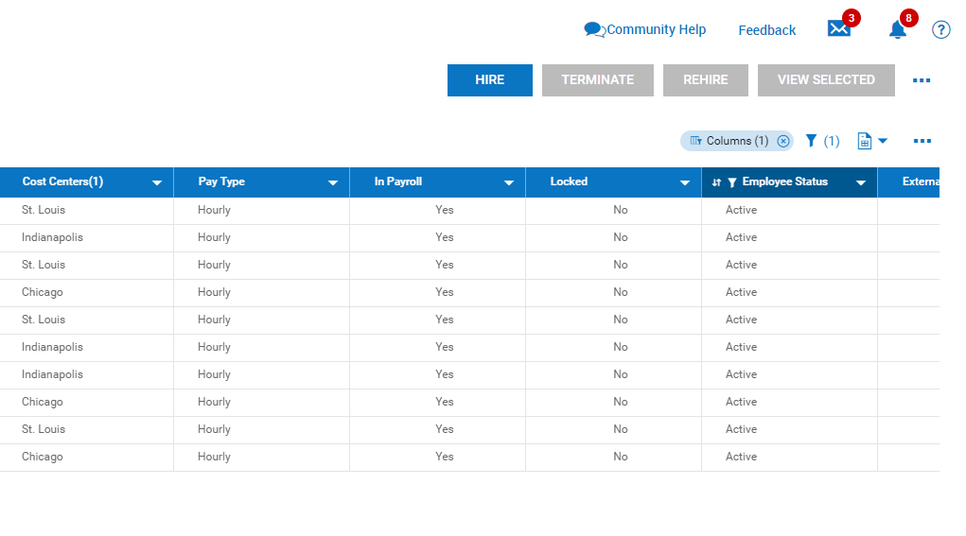
Column Filters
Quickly set value filters on multiple columns by clicking the pill icon.
Notes:
Note: second click reveals the column filters window.

Slide 30
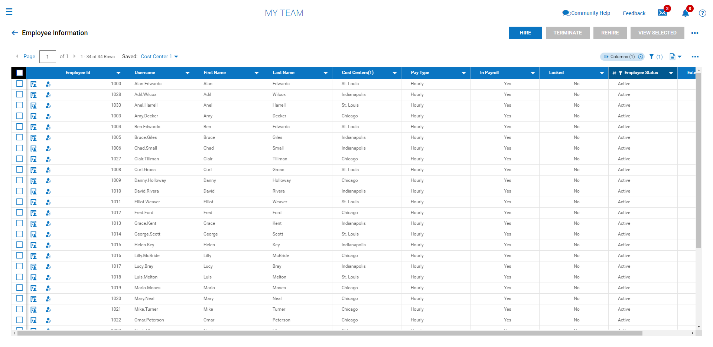
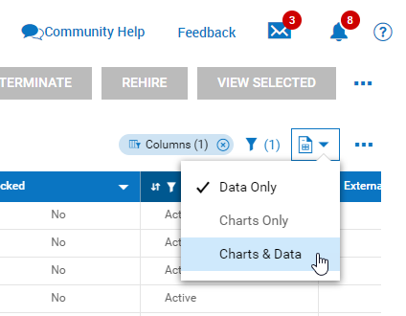
Charts & Graphs
Notes:
-Let’s talk about our newest feature: Charts. As you can see here, we have a lot of rows of information and it is difficult to make sense of this data. For example, maybe I want to know how many employees I have at each of my three locations. Or I’d like to know my company’s ratio of hourly to salary workers. This is where charts can help.
Note: 2 clicks reveal location of reports button and then drop-down.

Slide 31
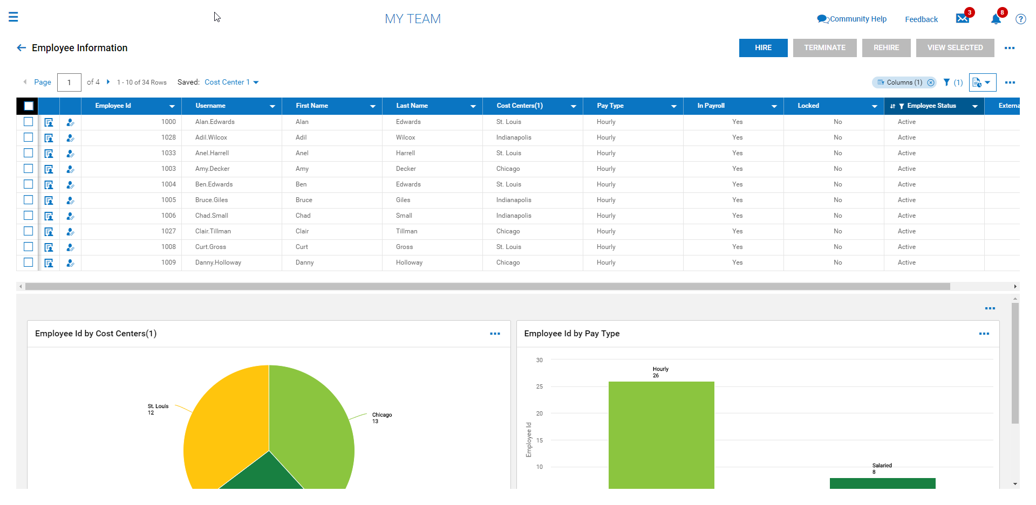
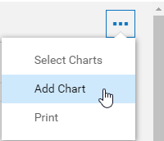
Charts & Graphs
Notes:
-This pie chart shows my distribution of employees by location, and this bar chart shows my ratio of hourly to salary. As you can see, charts bring a visual element to your data that helps you easily recognize patters and make better decisions.
-Charts are easy to add and create, too.
Note: 2 clicks show ellipsis location and drop-down.

Slide 32
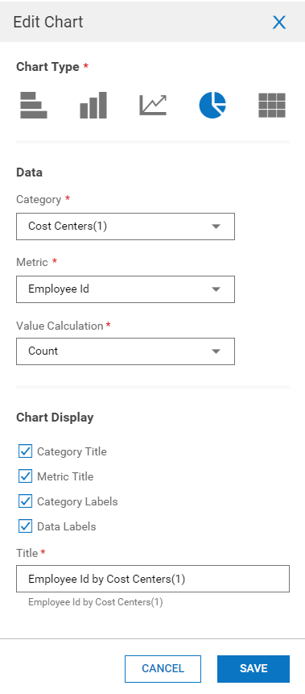
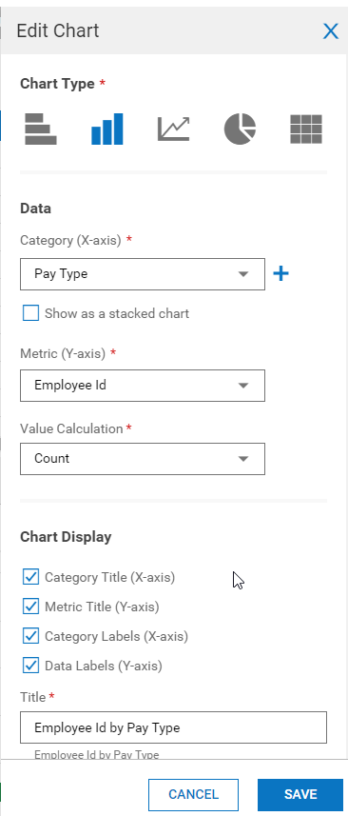
Charts & Graphs
Notes:
-The parameters you set in the window to the right dictate how your chart appears.
-(Click 1) select your chart type
-(Click 2) choose which data you want to visualize
-(Click 3) determine how you want the information to be displayed

Slide 33
Charts & Graphs
Notes:
Note: second example, just like previous.

Slide 34
Dashboards

Slide 35
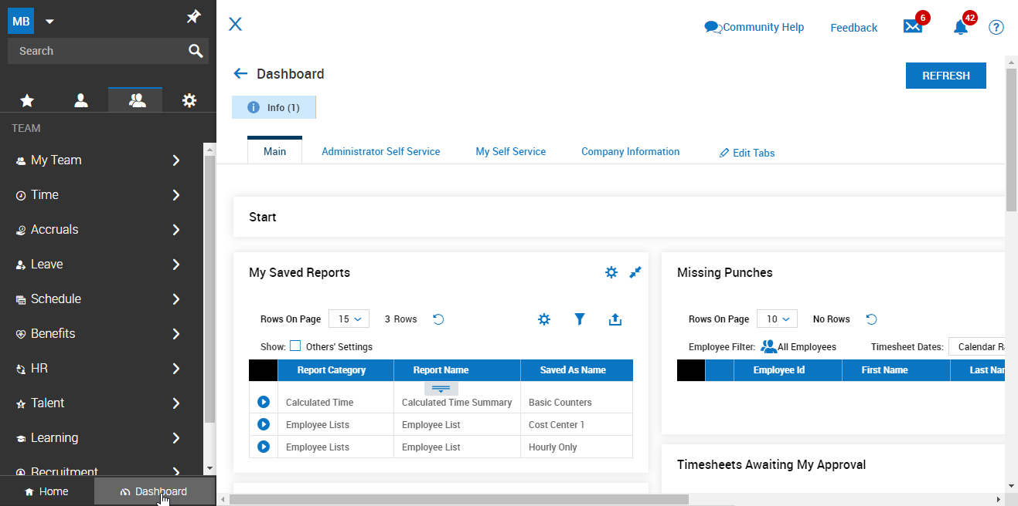
Classic Dashboard
Classic Dashboard experience available at bottom of menu.
Home is the New UI dashboard experience.

Slide 36
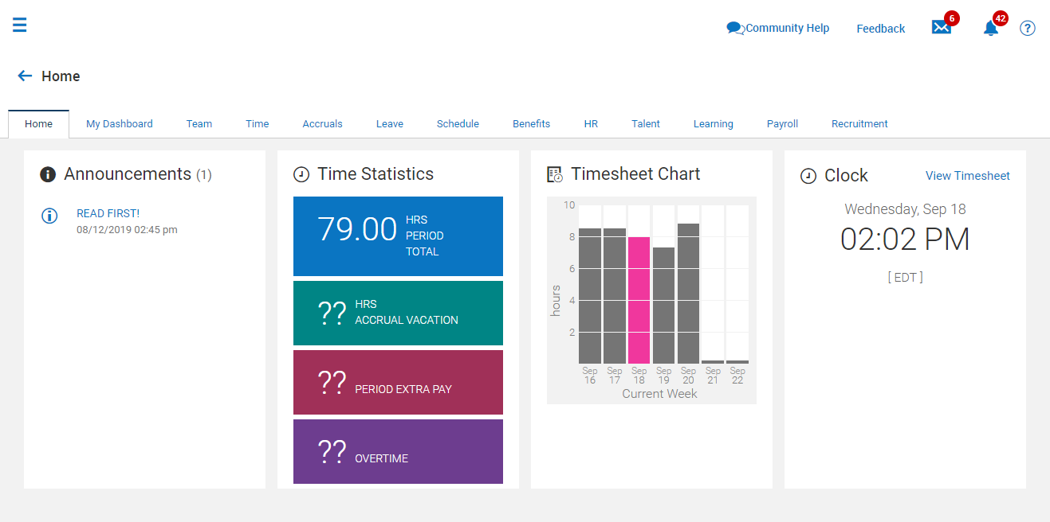
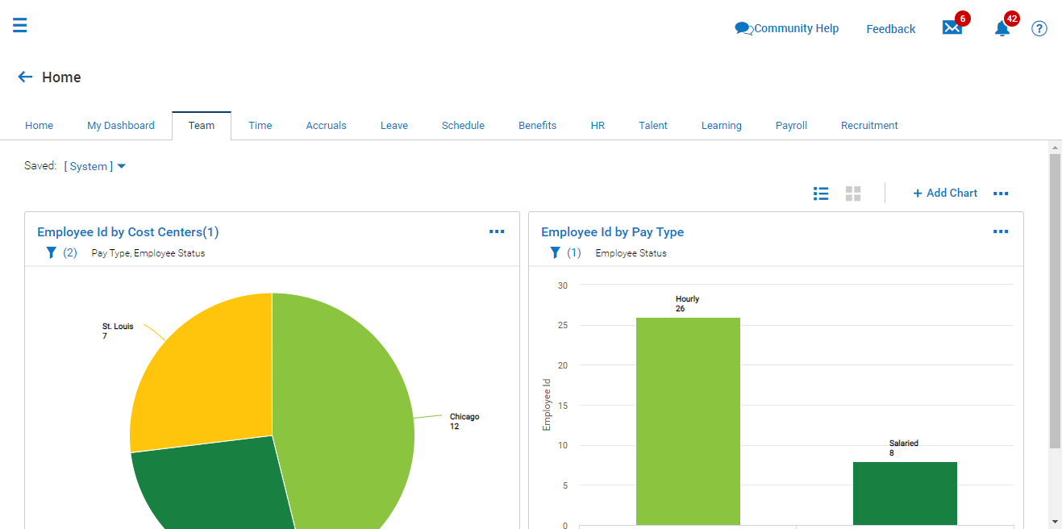
New UI Dashboard (HOME)
My Dashboard and module-specific dashboards are hubs for charts.
Home tab displays quick information widgets.
Notes:
-All of these dashboards can easily be configured to display relevant, actionable information to your managers.
Worth mentioning: Classic dashboard experience will be integrated with the new UI experience in 2020. Engineering is still building it out over next few releases.

Slide 37
Employee and Manager Experience

Slide 38
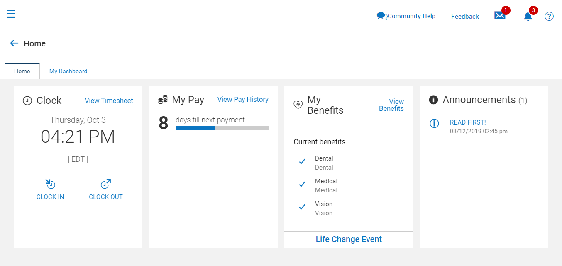
Employee Self Service
Employee Home widgets designed to meet employees’ most common needs.
Notes:
-Employees’ most common needs, such as clocking in or accessing pay statements can be done with a single click using widgets in their home screen.

Slide 39
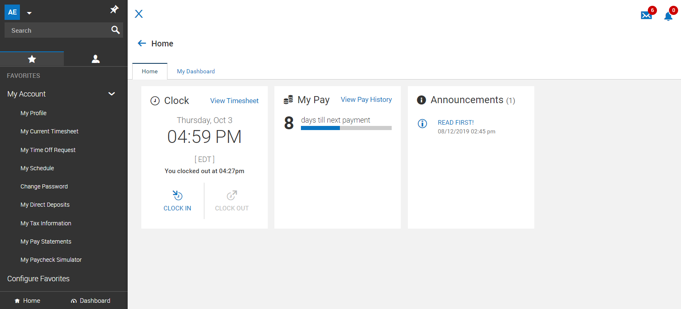
Employee Self Service
As always, Favorites may be configured to support frequently accessed employee tasks.
Notes:
-Favorites are another way to provide employees’ with quick access to their most commonly accessed items.

Slide 40
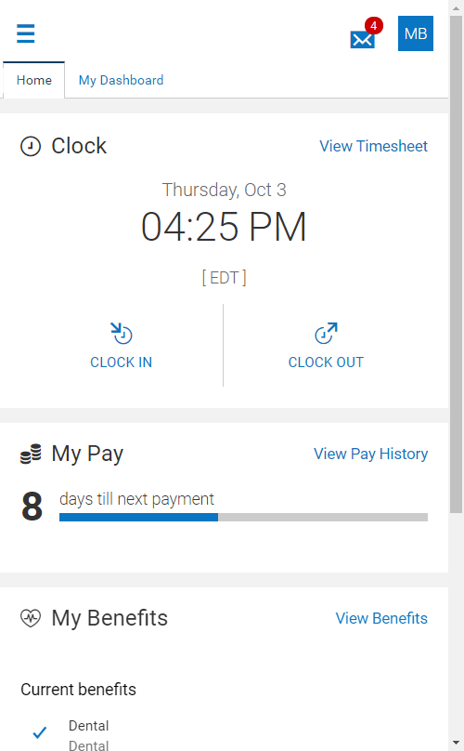
Employee Self Service
Exact same experience across employees’ multiple devices.
Notes:
-Because the system is responsive, the employee will have the same experience across all devices, meaning they will never have to think twice about where to go in the system. This is especially valuable today when so much is done via apps in our smartphone.

Slide 41
Employee Self Service
Intuitive experience guides employees’ actions.
Notes:
-Across all modules and devices, the experience is intuitive. The New UI is designed to minimize the amount of thinking required to complete any task. This means less training, fewer questions, and fewer mistakes.

Slide 42
Manager Self Service
All To-Do items can be completed or investigated from the To-Do page.
Notes:
Managers often have a variety of tasks to complete in the system, all of which are quickly accessed and completed by clicking the to-do bell in the upper right corner of the screen.

Slide 43
Manager Self Service
To-Do items can easily be completed in context, too.
Notes:
-Upon investigating to-do items more closely, tasks can be completed in context just as easily.

Slide 44
Manager Self Service
Search shortcuts allow for quick navigation to desired information.
Type # before a name to access that employee’s current timesheet.
Type % before a name to access that employee’s record.
Notes:
-Another way that managers can quickly move about the system is by using search shortcuts. For example, typing the pound sign before an employee’s name allows for direct navigation to that employee’s current timesheet. And typing the percentage sign ahead of a name gives quick access to the employee record.

Slide 45
Manager Self Service
Manager dashboards with charts foster efficient and effective decisions.

